Slide 1


A Data-Driven Exploration of Depression in Students

Slide 2



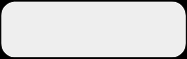
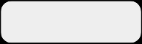
Team Members
Geum
Song
Ahn
Name
Kyunghoon Geum
Seungmin Song
Sunwoo Ahn
Role
Supervised Learning
Exploratory Data Analysis & Problem Definition
- Unsupervised Learning
- Analysis & Insights

Slide 3





Table of Contents
1
2
Dataset Overview
and
Structure
Numerical Feature
&
Depression relationship
3
4
Supervised Learning
Unsupervised Learning:
Verifying Relationships

Slide 4
Dataset Overview and Structure
Dataset Description
Target Distribution: Depression
Distribution of Numerical Variables
Distribution of Categorical Variables

Slide 5
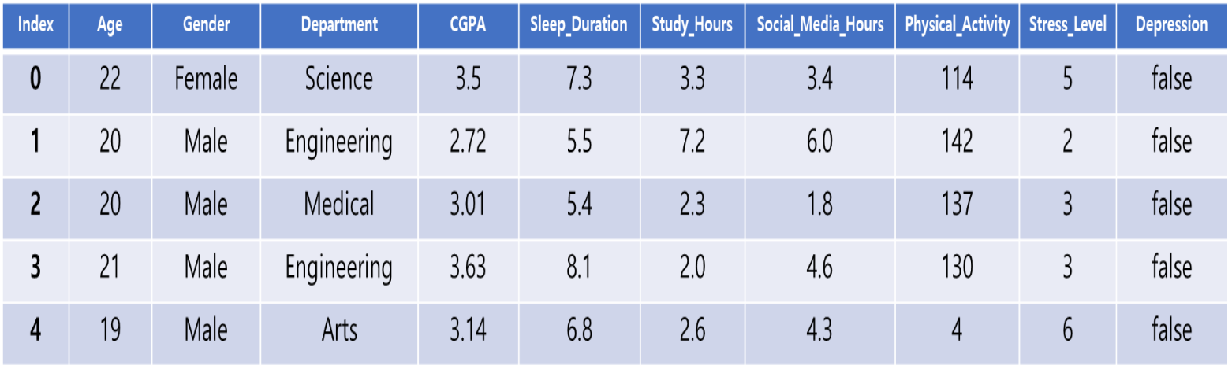
Dataset Description
문제 상황
Physical Activity and Stress Level represent self-reported measures of individual lifestyle and perceived stress.

Slide 6
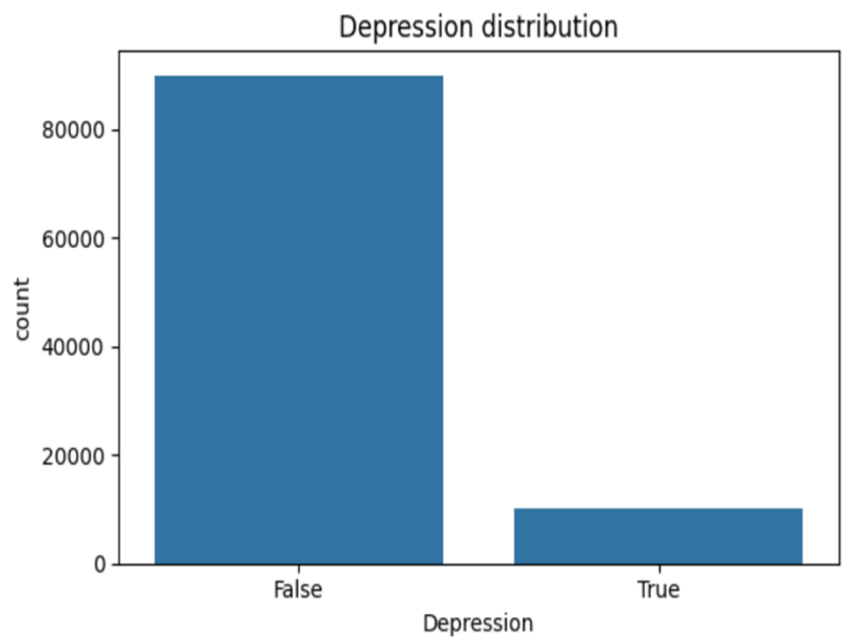
Target Distribution: Depression
문제 상황

Slide 7
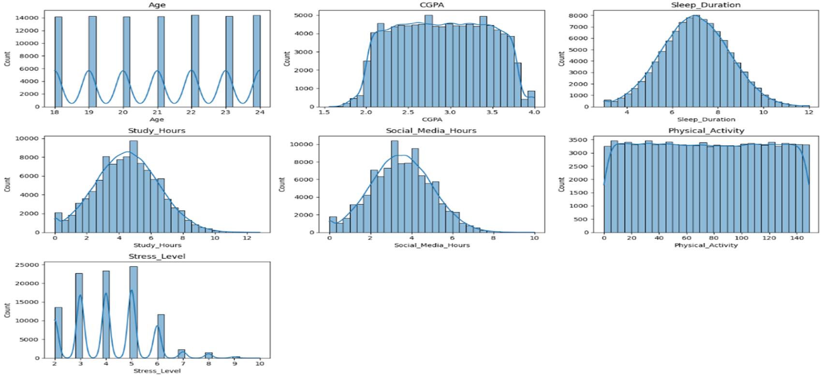
Distribution of Numerical Variables
문제 상황

Slide 8
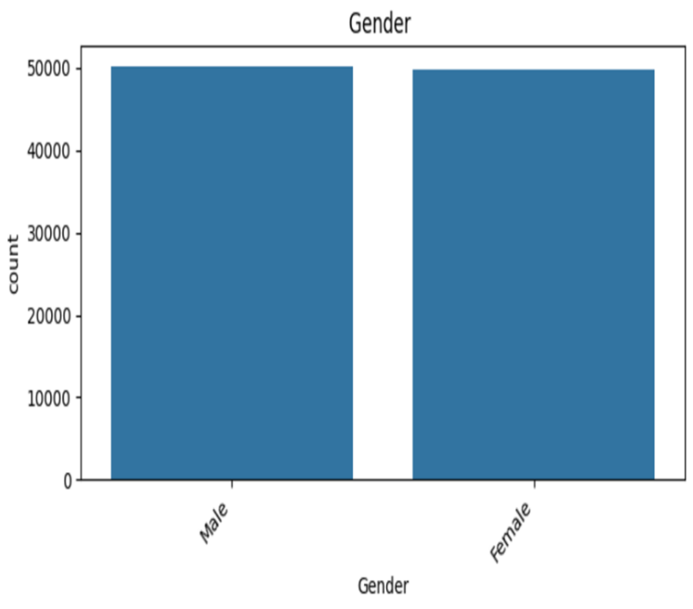
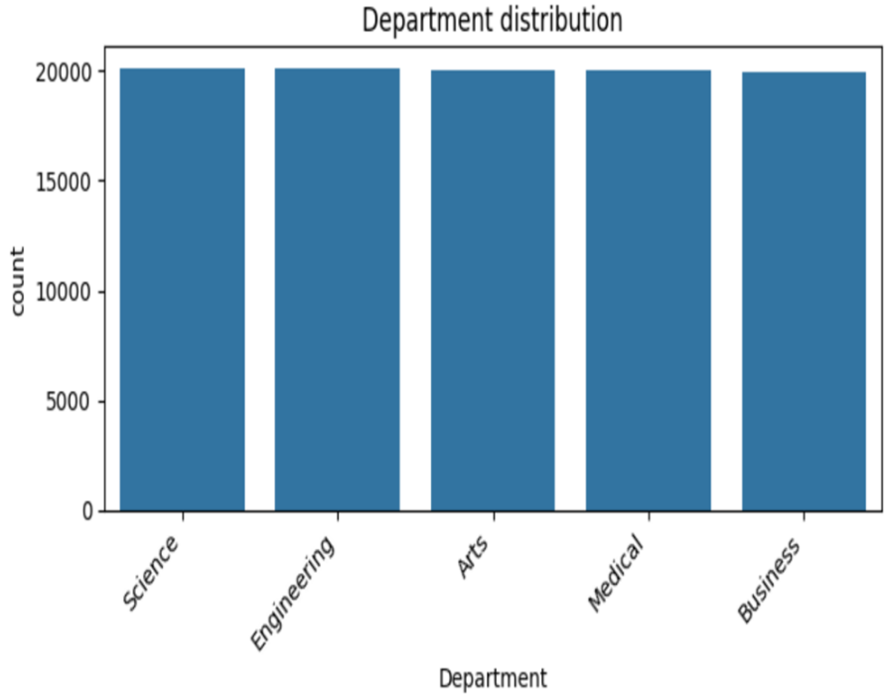
Distribution of Categorical Variables
문제 상황

Slide 9
Numerical Feature & Depression relationship
Numerical Feature
Summary of Mean Differences Between Depression Groups
Depression by Gender and Department

Slide 10
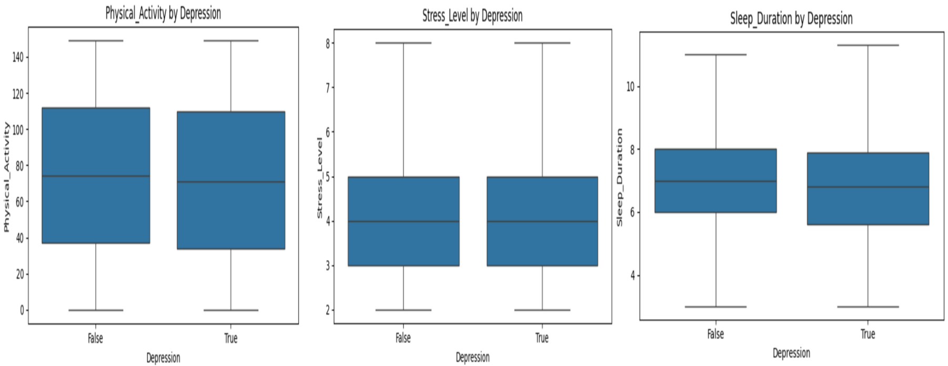
Numerical Feature
문제 상황

Slide 11
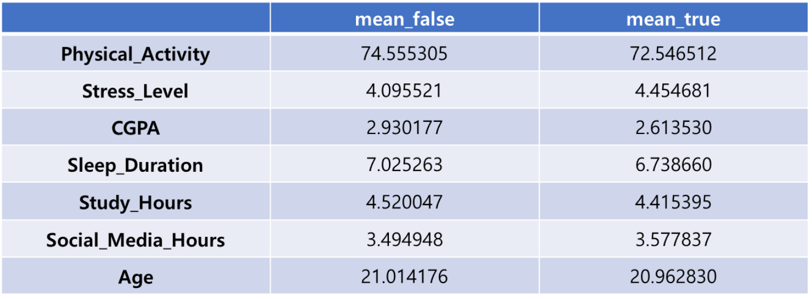
Summary of Mean Differences Between Depression Groups
문제 상황

Slide 12
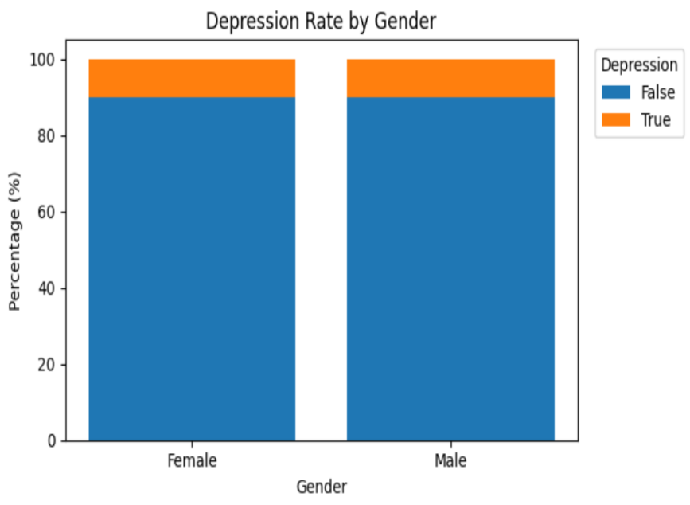
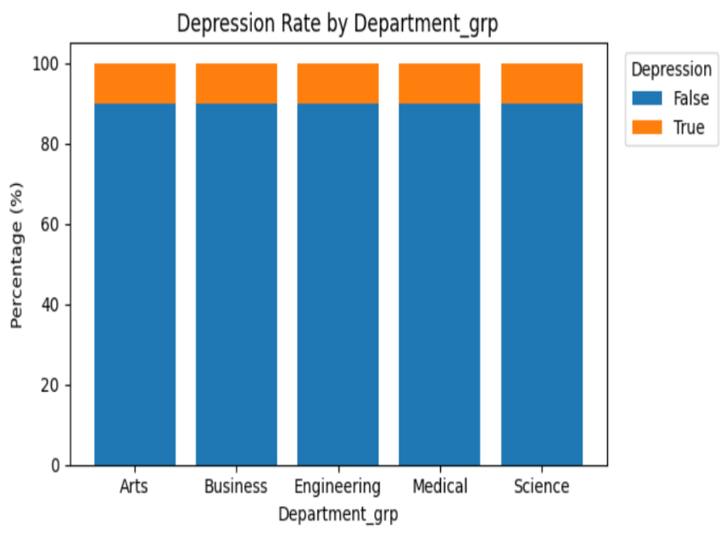
Depression by Gender and Department
문제 상황

Slide 13
Supervised Learning
Confusion Matrix
MIC (Mutual Information Coefficient)
Notes:
I’m gonna tell you how we evalutated our prediction model with confusion matrix, and how we analyzed relationship between variables with mutual information coefficient, or MIC.

Slide 14
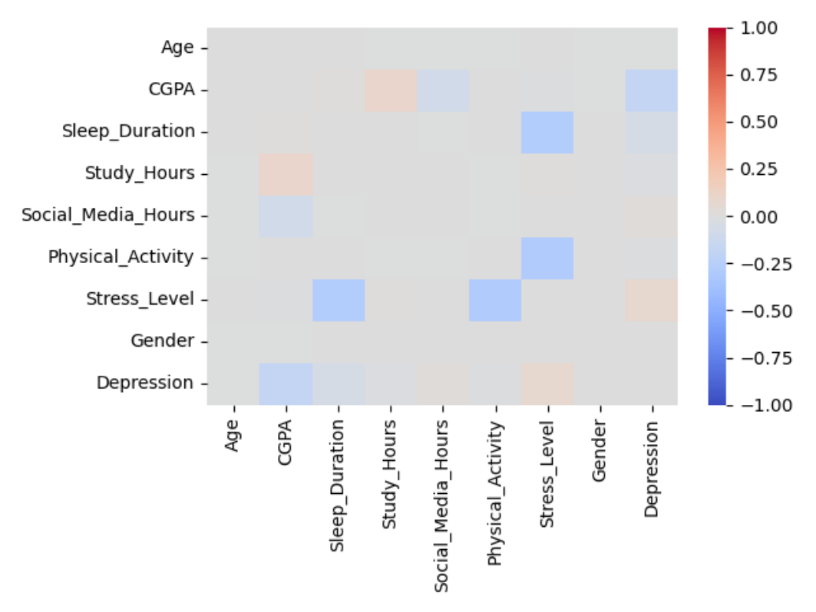
Correlation Heatmap
문제 상황
Notes:
Before Supervised Learning we had a look at correlation heatmap, there were no significant correlations, especially against Depression column, which is the target variable.

Slide 15
Supervised Learning
Model Used | Random Forest Classifier
Data Split | Training 80% / Test 20 %
Target Variable | Depression
Result Accuracy | 90%
문제 상황
Notes:
I used Random Forest Classifier for prediction. I split data 80% for training, 20% for test to predict if the student has Depression. As a result, it had 90% accuracy on test cases. But I had a doubt. If you remember the distribution of Depression, 90% of students were fine and only 10% were depressed. So I if predict everyone as fine, it is still 90% accurate. We needed a better way to evaluate the prediction which is ….

Slide 16
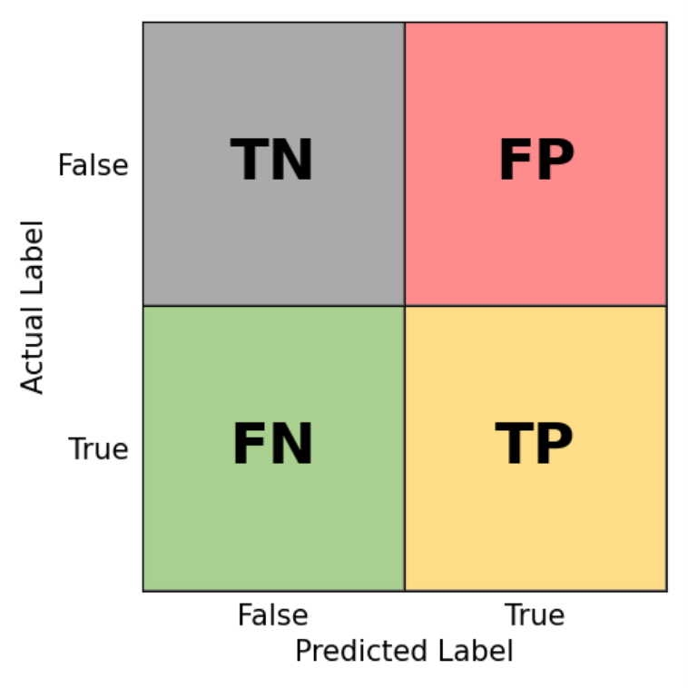
Confusion Matrix
문제 상황
Precision | Recall | F1-Score
TP / (FP + TP) | TP / (FN + TP) | 2/(1/Precision + 1/Recall)
Notes:
A Confusion Matrix. Let's define the four quadrants you see here:TN (True Negative): We correctly predicted a healthy student as 'False'.TP (True Positive): We correctly caught a student who actually has depression. FP (False Positive): we predicted depression, but the actually fine.FN (False Negative): A student is depressed, but we predicted they were fine.From these, we derive our three key metrics:Precision: Calculated as $TP / (FP + TP)$. This tells us: 'Of all the students we flagged as depressed, how many actually were?'Recall: Calculated as $TP / (FN + TP)$. This asks: 'Of all the students who truly have depression, how many did we successfully catch?'F1-Score: This is the harmonic mean of Precision and Recall. It’s a single score that balances both. I'm using macro average f1-score for both true case and false case. I know it's kinda hard to understand all of these features in a moment. but just remember this. Precision is yellow divided by pink and yello. recall is green divided by green and yellow. f1 score is overall score. and for all of them, the higher the number the better the prediction.

Slide 17
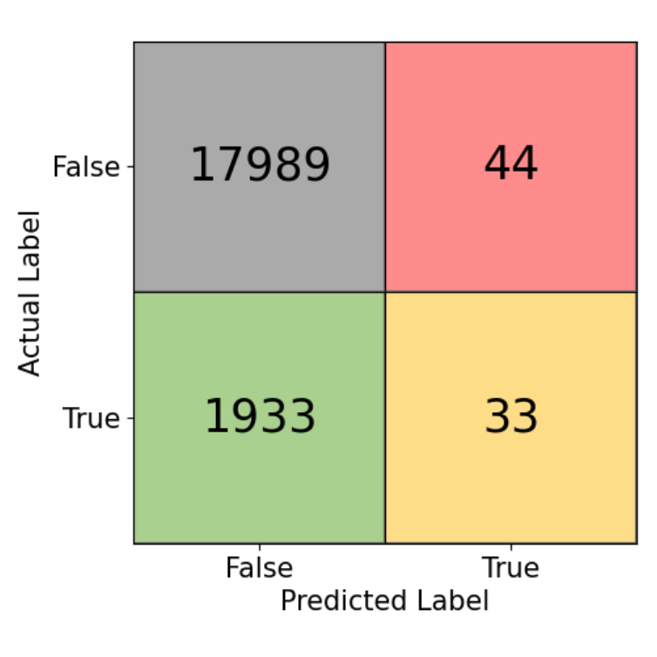
Confusion Matrix
문제 상황
Precision | Recall | F1-Score(macro)
0.436 | 0.017 | 0.473
Notes:
this is the result of our prediction. It was true that the model predicted most of the case as False. This results in the table below: a Precision of 0.436 and a Recall of only 0.017. I had to improve the prediction. I tried linear model to prevent overfitting.

Slide 18

Confusion Matrix
LogisticRegression
 | Precision | Recall | F1-Score(macro)
First | 0.436 | 0.017 | 0.473
Current | 0 | 0 | 0.474
Notes:
I used Logistic Regrssion for prediction. However, look at the matrix now. The model predicted False for every single case of depression. This resulted in a Recall of 0. I thought this is the limit of linear model. and I switched back to Random Foreset Classifier

Slide 19
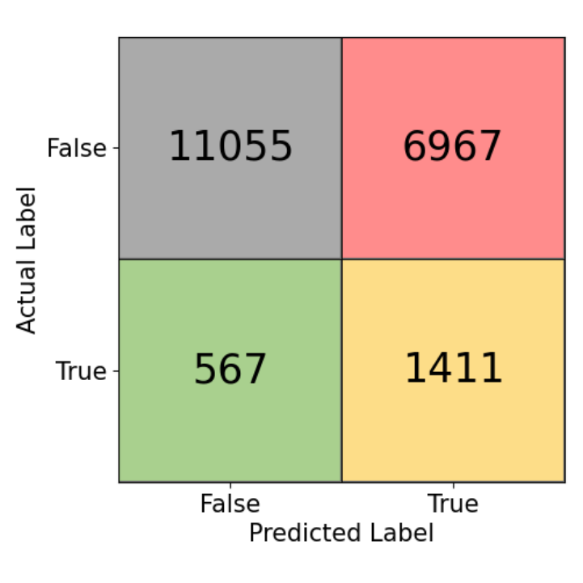
Confusion Matrix
threshold = 0.1
문제 상황
 | Precision | Recall | F1-Score(macro)
First | 0.436 | 0.017 | 0.473
Current | 0.17 | 0.71 | 0.51
Notes:
Since the model was too 'conservative,' I manually adjusted the classification threshold to 0.1, and now the result seems rather balanced.. or is it? True Positives jumped from 33 to 1,411.As the table shows, our Recall is now 0.71! But there's a trade-off. Our False Positives spiked to 6,967, causing our Precision to drop to 0.17. Our F1-Score slightly improved to 0.51.

Slide 20

Confusion Matrix
weight balanced
문제 상황
 | Precision | Recall | F1-Score(macro)
Last | 0.17 | 0.71 | 0.51
Current | 0.17 | 0.67 | 0.52
Notes:
In our final attempt, we used Weight Balancing. This tells the algorithm to treat each 'True' case as more important than a 'False' case. The current results show a Recall of 0.67 and a Precision of 0.17.Our F1-Score rised by 0.01. Meaningless. After all these adjustments, the performance is still not 'high.' This led us to investigate if the problem wasn't the model, but the data itself.

Slide 21
Why so low performance?
Hypothesis 1 : Non-linear relationship exists. Hypothesis 2 : No relationship exists.
문제 상황
Notes:
'Why so low performance?'. We had two possible conclusions 1: There exists a non-linear relationship that we are missing. 2: No relationship exists at all."

Slide 22
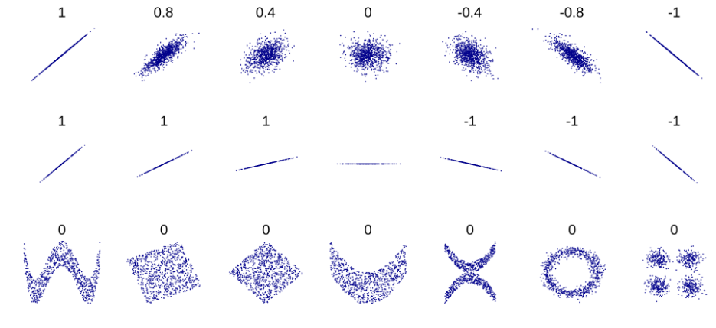
Verifying Absence of Relationship
MIC(Maximal Information Coefficient) Also detects non-linear relationship
문제 상황
Notes:
To test this, we used the MIC, or Maximal Information Coefficient. Look at the scatter plots on the screen . Standard Pearson correlation, the correlation coefficient that we are used to, only works for straight lines. they can't detect the relations in the bottom row, but MIC can.

Slide 23
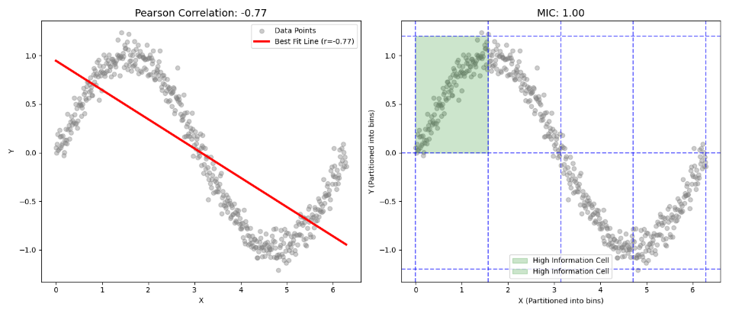
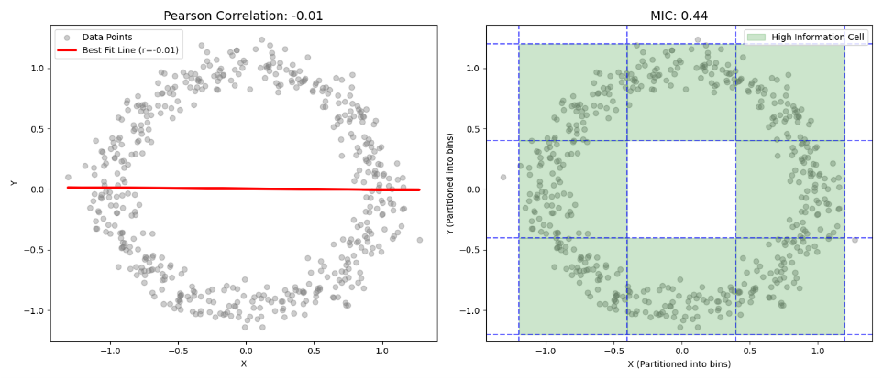
MIC
- Iteratively draws grid to find the one explain distribution best
- Calculates how well they're seperated
문제 상황
Notes:
How does it work? MIC iteratively draws different grids over the distribution to find the one that best explains the data. Look at the 'High Information Cells' highlighted in green on the plots. By calculating how well the data partitions into these bins, MIC can catch any pattern, no matter how 'weird' or non-linear it is.

Slide 24

MIC with Depression
0 | MIC | Pearson
CGPA | 0.036 | -0.181
Sleep Duration | 0.007 | -0.060
Study Hours | 0.001 | -0.015
Physical Activity | 0.001 | -0.015
Social Media Hours | 0.001 | 0.017
Age | too small | -0.006
MIC < 0.1 -> No Relationships!!!!
MIRICOMPANY
Notes:
So we calculated MIC for every features against depression. But as a result, as you can see, every features had MIC below 0.1. statistically mic lower than 0.1 means it has no relationships.

Slide 25
Why so low performance?
Hypothesis 1 : non-linear relationships exists. Hypothesis 2 : No relationship exists. - Wrong to blame external circumstances for the cause of depression
문제 상황
Notes:
We can now confidently reject Hypothesis 1 and confirm Hypothesis 2. the conclusion by so far, was that it is wrong to blame external circumstances—like how much a student studies or sleeps—as the sole cause of depression. Because our supervised models couldn't find a direct link, we decided to use Unsupervised Learning to see if there were hidden groups we were overlooking."

Slide 26
Unsupervised Learning: Verifying Relationships
Unsupervised Learning Process
Analysis & Insights

Slide 27
Unsupervised Learning Approach
Shift in Strategy :
Transitioned from Supervised to Unsupervised Learning to uncover hidden patterns.
Clustering Process: Processed 100,000 datasets using K-Means Clustering (k=4). Applied Standard Scaling (Numerical) & One-Hot Encoding (Categorical).
Dimensionality Reduction:
Utilized t-SNE to visualize 7-dimensional data on a 2D plane.

Slide 28
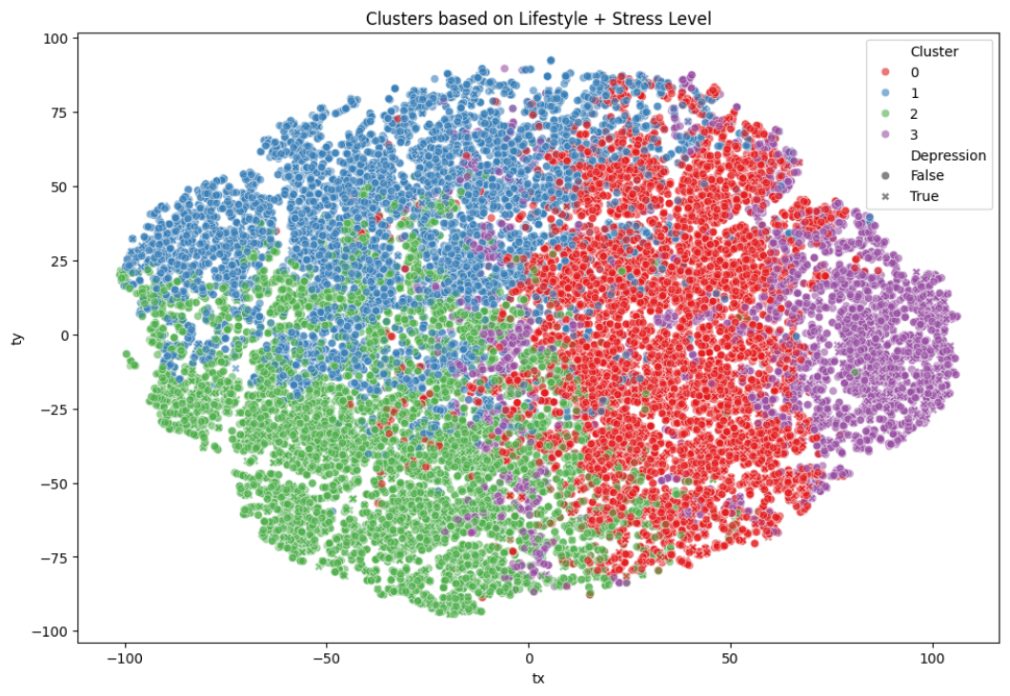
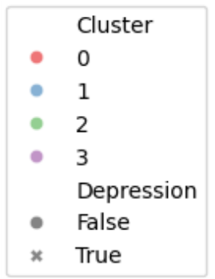
Clustering Chart
Multi-dimensional clustering performed using Age, Gender, CGPA, Sleep, Study, SNS usage, and Stress levels.

Slide 29
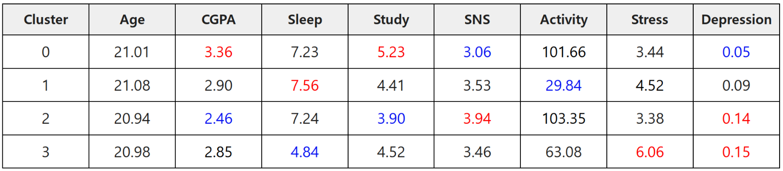
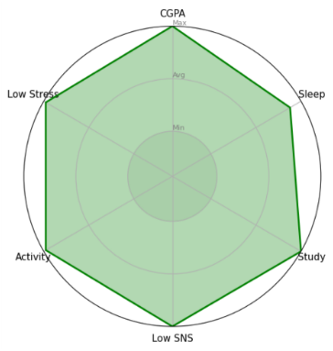
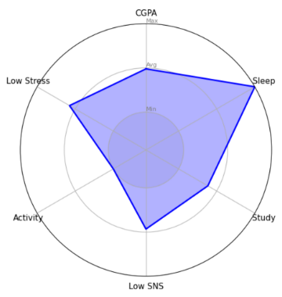
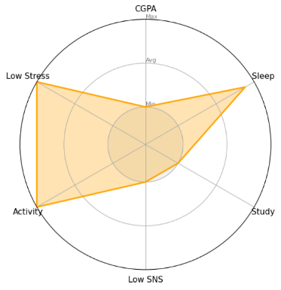
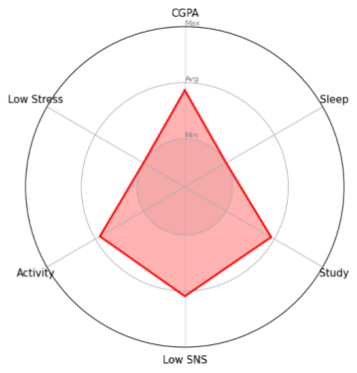
Visualizing Cluster Characteristics

Slide 30
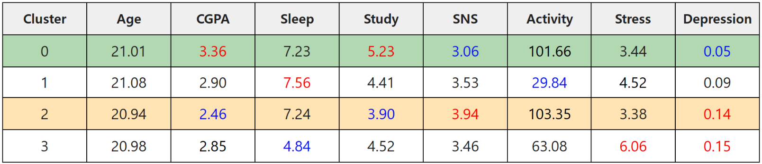
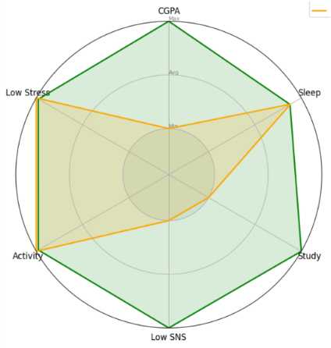
Impact of SNS on Academic Performance & Mental Health
Cluster 0 (Ideal) vs. Cluster 2 (Social):
A clear contrast in digital habits and academic outcomes. The Negative Correlation: High SNS Usage -> Low Study Duration -> Low CGPA. Mental Health Implication: Cluster 0 (High CGPA) : Depression rate is below the average (5%). Cluster 2 (Low CGPA) : Depression rate is 15%, exceeding the population average (10%)

Slide 31
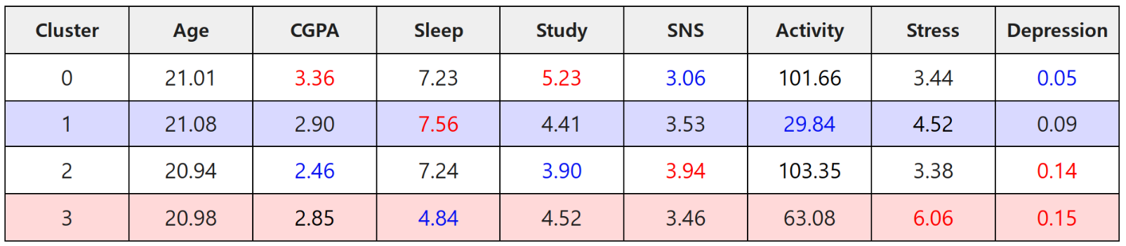
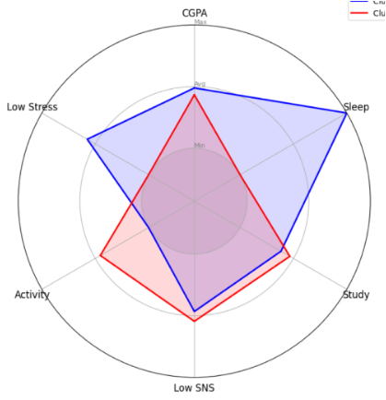
The Sleep-Activity Paradox
Hypothesis Rejection:
Contrary to the belief that "Low Activity leads to Depression" Cluster 1 (Lowest Activity) shows average mental health. The Critical Factor (Sleep): Cluster 3 (Burnout) : High Activity but Low Sleep results in the highest Stress & Depression levels. Key Insight:
Sleep Quality > Physical Activity. Takeaway:
Prioritizing rest is more effective for mental health than forced activity without sleep.

Slide 32
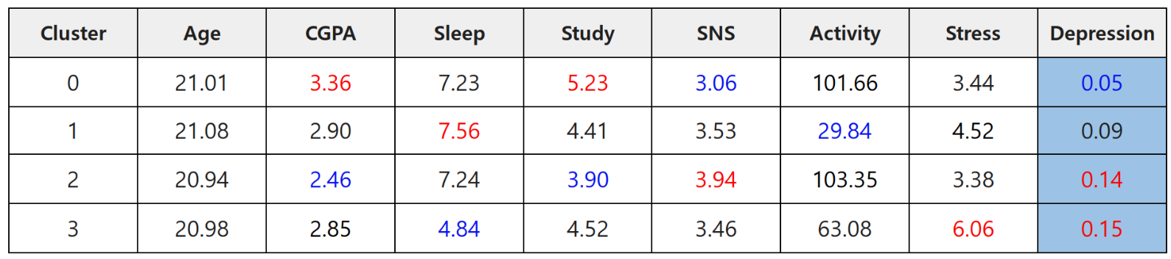
Conclusion: Lifestyle & Depression
Depression Rate Analysis: Global Average: 10% vs High-Risk Cluster: 15% The 5% difference indicates a correlation, but it is not a dominant cause. Final Verification: Lifestyle patterns are contributing factors, not the sole direct cause of depression. Future Direction : Need to explore external factors beyond lifestyle metrics.

Slide 33
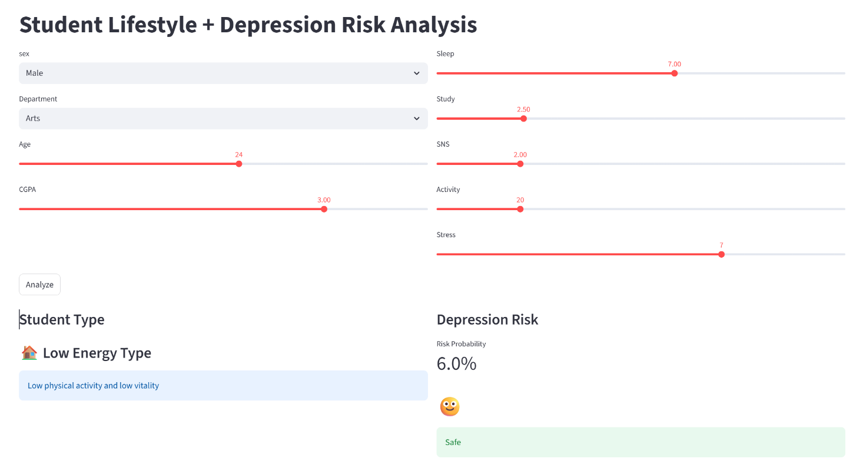
Demo

Slide 34

Thank You
강미리 팀장

